Slide 1
Front End Web
JavaScript Review and Discussion

Slide 2
Three Layers of Web Pages
Structure // HTML
Style // CSS
Interactive // JavaScript
Notes:
https://developer.mozilla.org/en-US/docs/Learn/JavaScript/First_steps/What_is_JavaScript

Slide 3
What is JavaScript?
JavaScript is a cross-platform, object-oriented scripting language. It is a small and lightweight language. Inside a host environment (for example, a web browser), JavaScript can be connected to the objects of its environment to provide programmatic control over them.
Source: https://developer.mozilla.org/en-US/docs/Web/JavaScript/Guide/Introduction
Notes:
A programming language is said to have First-class functions when functions in that language are treated like any other variable. For example, in such a language, a function can be passed as an argument to other functions, can be returned by another function and can be assigned as a value to a variable.
Node.js is a platform built on Chrome's JavaScript runtime for easily building fast and scalable network applications. Node.js uses an event-driven, non-blocking I/O model that makes it lightweight and efficient, perfect for data-intensive real-time applications that run across distributed devices.
https://www.tutorialspoint.com/nodejs/nodejs_introduction.htm

Slide 4
JavaScript is not Java

Slide 5
Advantages of JavaScript
JavaScript is very easy to implement. All you need to do is put your code in the HTML document and tell the browser that it is JavaScript.
JavaScript works on web users’ computers — even when they are offline!
JavaScript allows you to create highly responsive interfaces that improve the user experience and provide dynamic functionality, without having to wait for the server to react and show another page.
JavaScript can load content into the document if and when the user needs it, without reloading the entire page — this is commonly referred to as Ajax.
JavaScript can test for what is possible in your browser and react accordingly — this is called Principles of unobtrusive JavaScript or sometimes defensive Scripting.
JavaScript can help fix browser problems or patch holes in browser support — for example fixing CSS layout issues in certain browsers.
Source: https://www.w3.org/community/webed/wiki/What_can_you_do_with_JavaScript

Slide 6
Uses of JavaScript
A sign-up form can check if your user name is available when you enter it, preventing you from having to endure a frustrating reload of the page.
A search box can give you suggested results while you type, based on what you’ve entered so far (for example “bi” could bring up suggestions to choose from that contain this string, such as “bird”, “big” and “bicycle”). This usage pattern is called autocomplete.
Information that changes constantly can be loaded periodically without the need for user interaction, for example sports match results or stock market tickers.
Information that is a nice-to-have and runs the risk of being redundant to some users can be loaded when and if the user chooses to access it. For example the navigation menu of a site could be 6 links but display links to deeper pages on-demand when the user activates a menu item.

Slide 7
Uses of JavaScript Continued
JavaScript can fix layout issues. Using JavaScript you can find the position and area of any element on the page, and the dimensions of the browser window. Using this information you can prevent overlapping elements and other such issues. Say for example you have a menu with several levels; by checking that there is space for the sub-menu to appear before showing it you can prevent scroll-bars or overlapping menu items.
JavaScript can enhance the interfaces HTML gives us. While it is nice to have a text input box you might want to have a combo box allowing you to choose from a list of preset values or enter your own. Using JavaScript you can enhance a normal input box to do that.
You can use JavaScript to animate elements on a page — for example to show and hide information, or highlight specific sections of a page — this can make for a more usable, richer user experience. There is more information on this in the JavaScript animation article later on in the course.
Source: https://www.w3.org/community/webed/wiki/What_can_you_do_with_JavaScript

Slide 8
Be aware
JavaScript might not be available — this is easy to test for so not really a problem. Things that depend on JavaScript should be created with this in mind however, and you should be careful that your site does not break (ie essential functionality is not available) if JavaScript is not available.
If the use of JavaScript does not aid the user in reaching a goal more quickly and efficiently you are probably using it wrong.
Source: https://www.w3.org/community/webed/wiki/What_can_you_do_with_JavaScript

Slide 9
Be aware Continued
Using JavaScript we often break conventions that people have got used to over the years of using the web (for example clicking links to go to other pages, or a little basket icon meaning “shopping cart”).
We like being in control and once we understand something, it is hard for us to deal with change. Your JavaScript solutions should feel naturally better than the previous interaction, but not so different that the user cannot relate to it via their previous experience. If you manage to get a site visitor saying “ah ha — this means I don’t have to wait” or “Cool — now I don’t have to take this extra annoying step”— you have got yourself a great use for JavaScript.
JavaScript should never be a security measure. If you need to prevent users from accessing data or you are likely to handle sensitive data then don’t rely on JavaScript. Any JavaScript protection can easily be reverse engineered and overcome, as all the code is available to read on the client machine. Also, users can just turn JavaScript off in their browsers.
Source: https://www.w3.org/community/webed/wiki/What_can_you_do_with_JavaScript

Slide 10
Security
Buggy implementations used to crash the browser or execute code by using heap spraying attacks or similar. These can be kind of mitigated within modern browsers by using ASLR, DEP, sandboxes and similar techniques.
Cross Site Scripting (XSS) attacks can be used to steal authorization credentials (i.e. passwords) or hijack existing sessions. This way they can be used for identity theft or misuse. They work because the same browser is used for different web sites (i.e. banking and looking at cats) and this way it tears down security borders between these sites. Same Origin Policy is only of limited use in these cases.
A typical case of such attacks is the inclusion of third party scripts into a web site. This can be external Javascript libraries, tracking code like google analytics, buttons for social networks or advertisement. This included code is out of the control of the original web site but still has full access to the site inside the browser and can thus read information from it, fill in forms or read their content, navigate the user to different sites, press like buttons, inject advertisements or malware etc.
Apart from that Javascript can be used to fingerprint the browser in a more detailed way which might be a problem especially when trying to be anonymous.
Source: https://security.stackexchange.com/questions/110850/what-are-the-exact-security-risks-of-having-javascript-enabled
Notes:
http://www.computerweekly.com/tip/Vulnerabilities-in-JavaScript-Secure-coding-insights-and-tips

Slide 11

The D.O.M.

Slide 12
JavaScript and the D.O.M.
With the object model, JavaScript gets all the power it needs to create dynamic HTML:
JavaScript can change all the HTML elements in the page
JavaScript can change all the HTML attributes in the page
JavaScript can change all the CSS styles in the page
JavaScript can remove existing HTML elements and attributes
JavaScript can add new HTML elements and attributes
JavaScript can react to all existing HTML events in the page
JavaScript can create new HTML events in the page
Source: https://www.w3schools.com/js/js_htmldom.asp

Slide 13
JavaScript accesses the D.O.M.
<html> <body> <p id="demo"></p> <script> document.getElementById("demo").innerHTML = "Hello World!"; </script> </body> </html>

Slide 14
The B.O.M.
The Browser Object Model (BOM)
There are no official standards for the Browser Object Model (BOM).
Since modern browsers have implemented (almost) the same methods and properties for JavaScript interactivity, it is often referred to, as methods and properties of the BOM.

Slide 15
The B.O.M. Window and Location
Window - browser's window
Screen
screen.width
screen.height
screen.availWidth
screen.availHeight
screen.colorDepth
screen.pixelDepth
Location
window.location.href returns the href (URL) of the current page
window.location.hostname returns the domain name of the web host
window.location.pathname returns the path and filename of the current page
window.location.protocol returns the web protocol used (http: or https:)
window.location.assign loads a new document

Slide 16
The B.O.M. History, Navigator, Pop-up, Timing, Cookies
History
history.back() - same as clicking back in the browser
history.forward() - same as clicking forward in the browser
Navigator
navigator.appName
navigator.appCodeName
navigator.platform
Pop-up Alert
Alert box
Confirm box
Prompt box
Timing
setTimeout(function, milliseconds) Executes a function, after waiting a specified number of milliseconds.
setInterval(function, milliseconds) Same as setTimeout(), but repeats the execution of the function continuously.
Cookies

Slide 17
JavaScript and APIs
Browser APIs
The DOM (Document Object Model) API allows you to manipulate HTML and CSS, creating, removing and changing HTML, dynamically applying new styles to your page, etc.
The Geolocation API retrieves geographical information. This is how Google Maps is able to find your location, and plot it on a map.
The Canvas and WebGL APIs allow you to create animated 2D and 3D graphics.
Audio and Video APIs like HTMLMediaElement and WebRTC allow you to do really interesting things with multimedia, such as play audio and video right in a web page, or grab video from your web camera and display it on someone else's computer.
Source: https://developer.mozilla.org/en-US/docs/Learn/JavaScript/First_steps/What_is_JavaScript
Notes:
APIs allow programmers to connect systems. e.g. embedding a google map in a web page or adding a Facebook like button.

Slide 18
JavaScript and APIs 3rd Party
3rd party APIs
The Twitter API allows you to do things like displaying your latest tweets on your website.
The Google Maps API allows you to embed custom maps into your website, and other such functionality.

Slide 19
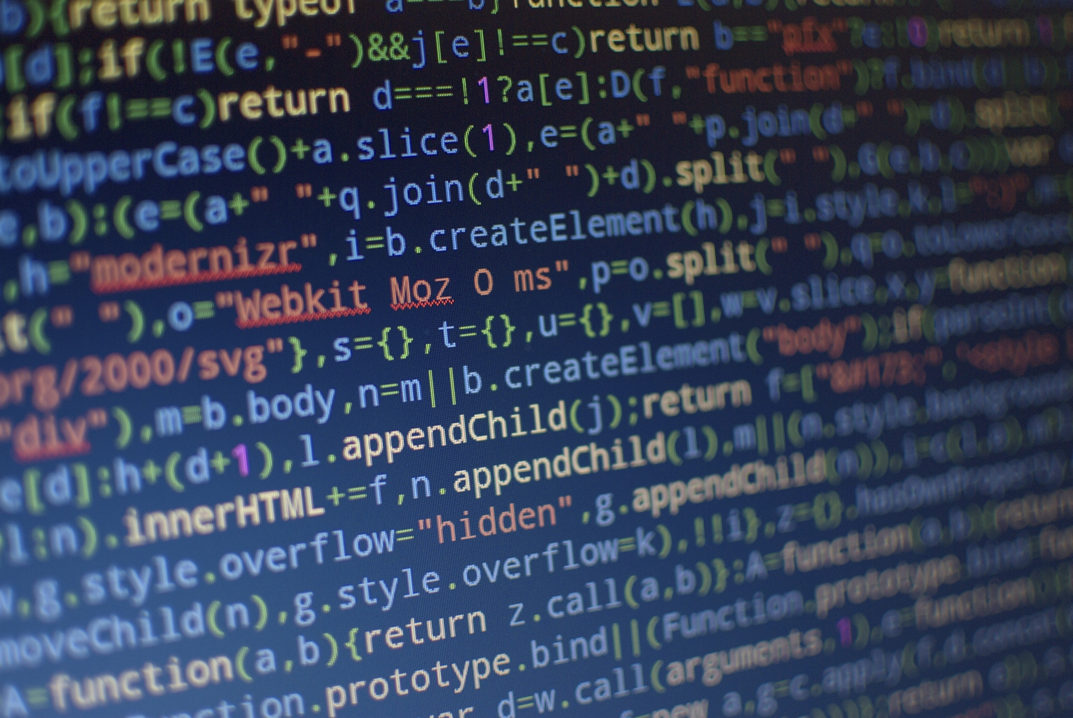
Code Example
Source: https://developer.mozilla.org/en-US/docs/Learn/JavaScript/First_steps/A_first_splash
Notes:
View code files here

Slide 20
What is a variable?
In a programming language, variables are used to store data values.
JavaScript uses the var keyword to declare variables.
An equal sign is used to assign values to variables.
In this example, x is defined as a variable. Then, x is assigned (given) the value 6:
var x; x = 6;
var x = 6;
Source: https://www.w3schools.com/js/js_syntax.asp

Slide 21
Declare Variables
Creating a variable in JavaScript is called "declaring" a variable.
var x (undefined)
var x = 52

Slide 22
Variables
You use variables as symbolic names for values in your application. The names of variables, called identifiers, conform to certain rules.
A JavaScript identifier must start with a letter, underscore (_), or dollar sign ($); subsequent characters can also be digits (0-9). Because JavaScript is case sensitive, letters include the characters "A" through "Z" (uppercase) and the characters "a" through "z" (lowercase).
You can use most of ISO 8859-1 or Unicode letters such as å and ü in identifiers. You can also use the Unicode escape sequences as characters in identifiers.
Some examples of legal names are Number_hits, temp99, $credit, and _name.

Slide 23
Variable Scope
When you declare a variable outside of any function, it is called a global variable, because it is available to any other code in the current document.
When you declare a variable within a function, it is called a local variable, because it is available only within that function.

Slide 24
Variable hoisting
Another unusual thing about variables in JavaScript is that you can refer to a variable declared later, without getting an exception.
This concept is known as hoisting; variables in JavaScript are in a sense "hoisted" or lifted to the top of the function or statement.
However, variables that are hoisted will return a value of undefined. So even if you declare and initialize after you use or refer to this variable, it will still return undefined.
Because of hoisting, all var statements in a function should be placed as near to the top of the function as possible. This best practice increases the clarity of the code.

Slide 25
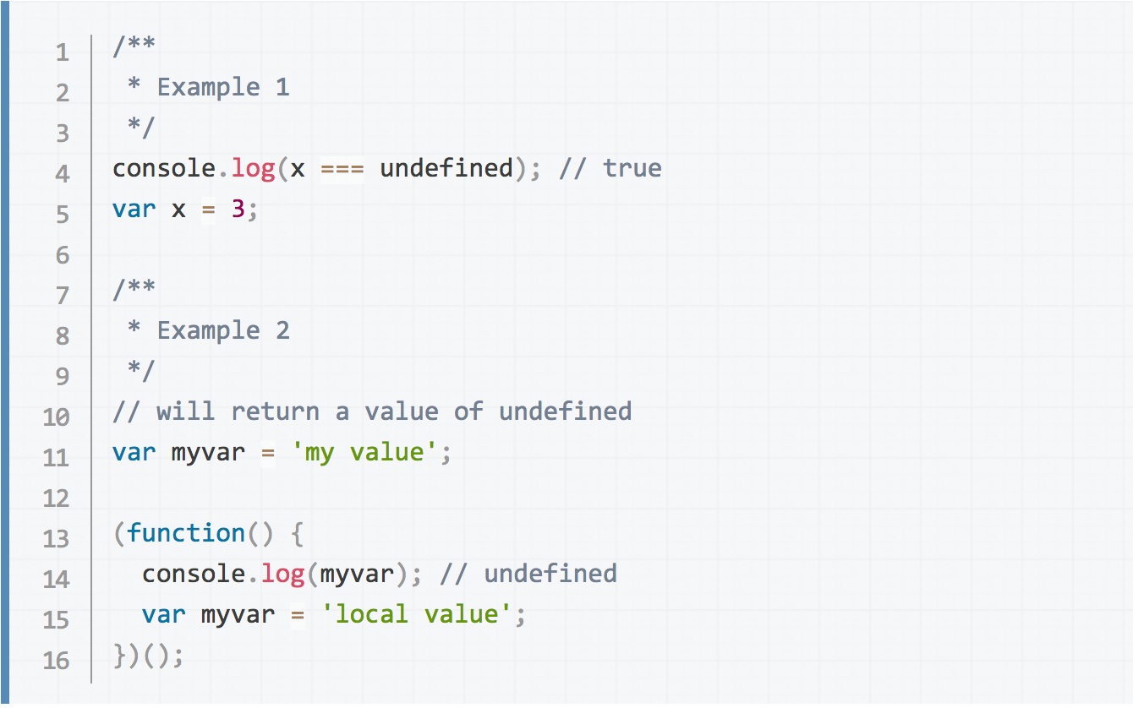
Variable Hoisting Example

Slide 26
Global variables
Global variables are in fact properties of the global object. In web pages the global object is window, so you can set and access global variables using the window.variable syntax.
Consequently, you can access global variables declared in one window or frame from another window or frame by specifying the window or frame name. For example, if a variable called phoneNumber is declared in a document, you can refer to this variable from an iframe as parent.phoneNumber.

Slide 27
Data Types
Six data types that are primitives: Boolean. true and false.
null. A special keyword denoting a null value. Because JavaScript is case-sensitive, null is not the same as Null, NULL, or any other variant.
undefined. A top-level property whose value is undefined.
Number. 42 or 3.14159.
String. "Howdy"
Symbol (new in ECMAScript 2015). A data type whose instances are unique and immutable.
You don’t have to declare the data type. It is done automatically with JavaScript.

Slide 28
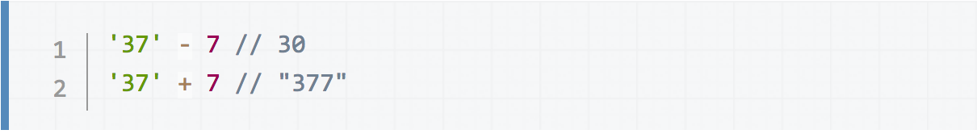
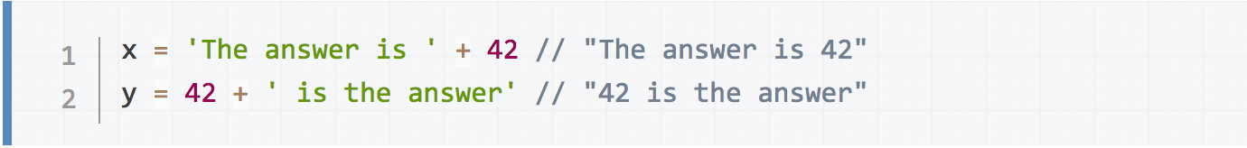
Working with JavaScript

Slide 29
Working with JavaScript
Objects and functions are the other fundamental elements in the language.
You can think of objects as named containers for values, and functions as procedures that your application can perform.

Slide 30
Literal Types: Arrays
An array literal is a list of zero or more expressions, each of which represents an array element, enclosed in square brackets ([]). When you create an array using an array literal, it is initialized with the specified values as its elements, and its length is set to the number of arguments specified.

Slide 31
Count arrays starting with 0
coffees[0] = French Roast
coffees[1] = Colombian
coffees[2] = Kona

Slide 32
Other Literal Types
Boolean : True || False
Integers : Numbers
Floating-point : Numbers with decimals and/or (+/-)
RegExp : A regexp literal is a pattern enclosed between slashes. var re = /ab+c/;
String : Characters enclosed in single or double quotes ‘foo’
Object : A list of 0 or more pairs of names and values
myObj = { "name":"John", "age":30, "car":null };

Slide 33
Objects
Objects are like variables with many data points
var car = "Fiat";
var car = {type:"Fiat", model:"500", color:"white"};
Try it: https://www.w3schools.com/js/tryit.asp?filename=tryjs_objects_properties_1

Slide 34
Escaping Characters
var quote = "He read \"The Cremation of Sam McGee\" by R.W. Service.";
OUTPUT of quote: He read "The Cremation of Sam McGee" by R.W. Service.
Escape line breaks
var str = 'this string \ is broken \ across multiple \ lines.' console.log(str); // this string is broken across multiplelines.
Source: https://developer.mozilla.org/en-US/docs/Web/JavaScript/Guide/Grammar_and_Types#Array_literals

Slide 35
JSON
JSON is Object Data
JSON: JavaScript Object Notation.
JSON is a syntax for storing and exchanging data.
JSON is text, written with JavaScript object notation.
var person = { "name":"John", "age":31, "city":"New York" };
NOTE: JSON names require double quotes. JavaScript names don't.
Source: https://www.w3schools.com/js/js_json_intro.asp

Slide 36
JSON Data
{ "name":"John", "age":30, "cars":[ "Ford", "BMW", "Fiat" ] }

Slide 37
CSS - Data-* attributes
The data-* attributes is used to store custom data private to the page or application.
The data-* attributes gives us the ability to embed custom data attributes on all HTML elements.
The stored (custom) data can then be used in the page's JavaScript to create a more engaging user experience (without any Ajax calls or server-side database queries).
The data-* attributes consist of two parts:
The attribute name should not contain any uppercase letters, and must be at least one character long after the prefix "data-"
The attribute value can be any string
Note: Custom attributes prefixed with "data-" will be completely ignored by the user agent.
Try It: https://www.w3schools.com/tags/att_data-.asp

Slide 38
Code Examples
Resources: https://www.w3schools.com/js/tryit.asp?filename=tryjson_parse
https://developers.facebook.com/tools/explorer/145634995501895/?method=GET&path=me%3Ffields%3Did%2Cname&version=v2.10
Notes:
https://www.w3schools.com/js/tryit.asp?filename=tryjson_parse
https://developers.facebook.com/tools/explorer/145634995501895/?method=GET&path=me%3Ffields%3Did%2Cname&version=v2.10

Slide 39
Events
Event handlers can be used to handle, and verify, user input, user actions, and browser actions:
Things that should be done every time a page loads
Things that should be done when the page is closed
Action that should be performed when a user clicks a button
Content that should be verified when a user inputs data
And more ...
Many different methods can be used to let JavaScript work with events:
HTML event attributes can execute JavaScript code directly
HTML event attributes can call JavaScript functions
You can assign your own event handler functions to HTML elements
You can prevent events from being sent or being handled
And more ...
Try It: https://www.w3schools.com/js/js_events.asp

Slide 40
Conditional Statements
Conditional Statements
Very often when you write code, you want to perform different actions for different decisions.
You can use conditional statements in your code to do this.
In JavaScript we have the following conditional statements:
Use if to specify a block of code to be executed, if a specified condition is true
Use else to specify a block of code to be executed, if the same condition is false
Use else if to specify a new condition to test, if the first condition is false
Use switch to specify many alternative blocks of code to be executed
Try It: https://www.w3schools.com/js/js_if_else.asp

Slide 41
Loops
Loops are handy, if you want to run the same code over and over again, each time with a different value.
Instead of this:
text += cars[0] + "<br>"; text += cars[1] + "<br>"; text += cars[2] + "<br>"; text += cars[3] + "<br>"; text += cars[4] + "<br>"; text += cars[5] + "<br>";
---------------------vv or better this vv-------------------------------
for (i = 0; i < cars.length; i++) { text += cars[i] + "<br>"; }

Slide 42
Error Handling
Errors will happen.
Important to deliver error-free code
Try It: https://www.w3schools.com/js/js_errors.asp

Slide 43
Debugging Tools
Console
http://www.jslint.com/

Slide 44
Performance
Reduce Activity in Loops
Statements or assignments that can be placed outside the loop will make the loop run faster.
var i; for (i = 0; i < arr.length; i++) {
// -- vv better vv -- //
var i; var l = arr.length; for (i = 0; i < l; i++) {
Reduce DOM Access
If you expect to access a DOM element several times, access it once, and use it as a local variable

Slide 45
Performance Tactics
Reduce DOM Size
Avoid Unnecessary Variables
Delay JavaScript Loading
Putting your scripts at the bottom of the page body lets the browser load the page first.
The HTTP specification defines that browsers should not download more than two components in parallel.
An alternative is to use defer="true" in the script tag. The defer attribute specifies that the script should be executed after the page has finished parsing, but it only works for external scripts.

Slide 46
JavaScript Style
Make JavaScript more readable by:
Use white space. JavaScript ignores white space.
Use line breaks. JavaScript ignores line breaks.
Block code with line breaks and tabs. function myFunction() { document.getElementById("demo1").innerHTML = "Hello Dolly!"; document.getElementById("demo2").innerHTML = "How are you?"; }
Camel Case

Slide 47
Camel Case
JavaScript programmers tend to use camel case that starts with a lowercase letter:
firstName, lastName, masterCard, interCity.
NOTE: Hyphens are not allowed in JavaScript. It is reserved for subtractions.

Slide 48
Style Guides to Consider
https://google.github.io/styleguide/jsguide.html
https://contribute.jquery.org/style-guide/js/
https://github.com/felixge/node-style-guide/
https://make.wordpress.org/core/handbook/best-practices/coding-standards/javascript/
https://developer.mozilla.org/en-US/docs/Mozilla/Developer_guide/Coding_Style/

Slide 49
Why conform to one format (or style)?
Why have coding guidelines? Why not let each developer use their own style and patterns at will? In our experience, there are a few good reasons:
reading code becomes easier. You can actually discern patterns visually without having to read each token. This greatly speeds up reading each others' code
It speeds up writing code. If you have simple rules to follow when writing code, you don't have to make judgements about how it looks. You have more brainpower left to think about the important things (such as if you have an off-by-1 error..., potential NPEs, semantic bugs, ...)
they should encapsulate shared experience of many developers, and hence help one developer not make the same error another did in the past
Source: https://github.com/facebook/jcommon/wiki/Coding-Standards

Slide 50
W3C JS Quiz
https://www.w3schools.com/js/js_quiz.asp

Slide 51


